Slide 1
Monitoring the CLMU
COPS Training Part 5

Slide 2
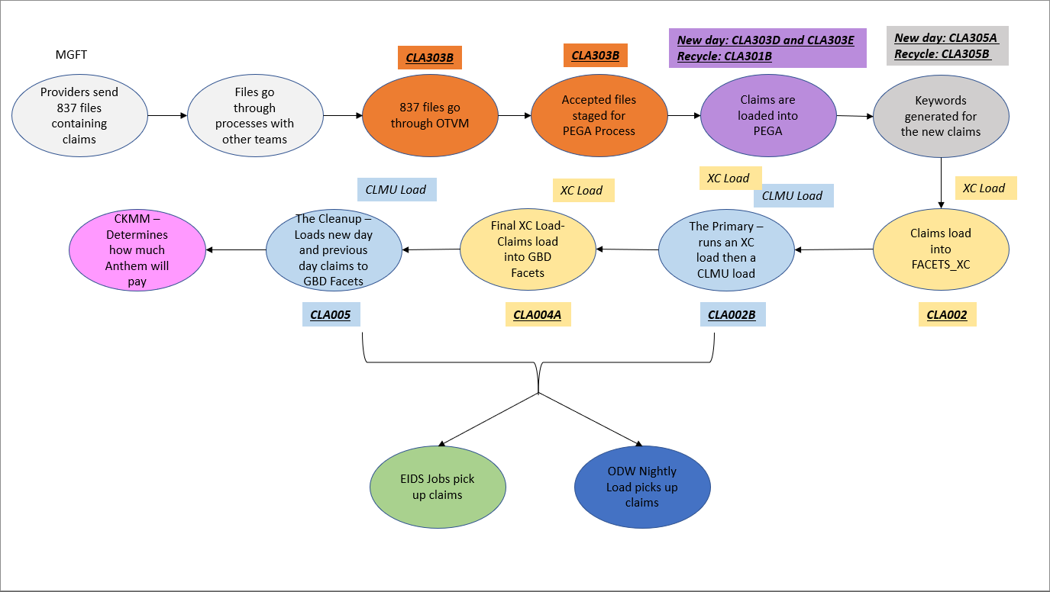

Slide 3
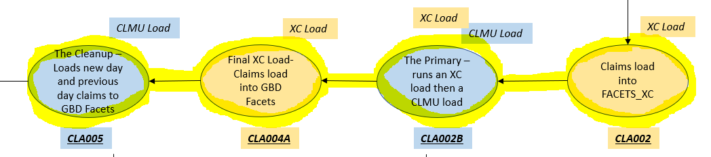
CLMU and XC Loads
3 XC Loads
CLA002
CLA002B Step 10
CLA004A
2 CLMU Loads
CLA002B Step 20- The Primary
CLA005 Step 20 – The Cleanup
CLA015 Step 10 – The Weekend Cleanup

Slide 4
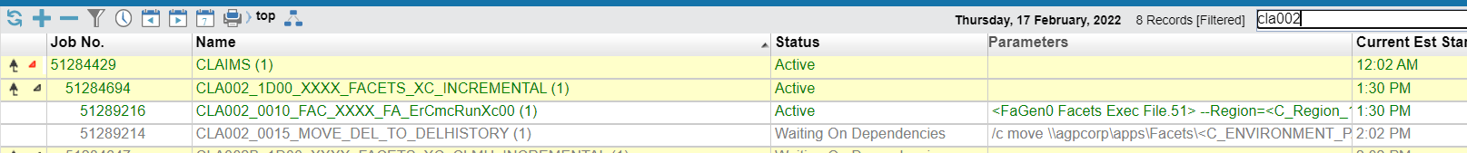
CLA002
The first XC load kicks off at 1:30PM
CLA002
This moves keywords that have been generated up until 1:30PM from PEGA to the FACETS_XC staging table
FAQs:
This does not stop claim loading to PEGA, that will continue via CLA303D
This does not stop keyword generation, that will continue via CLA305A
This loads the keywords to Facets_XC, so we need keywords to be generated, but it does not stop claim loading or keyword generation

Slide 5
CLA002B_0010
The second XC load starts at 2:30PM
CLA002B Step 10
This moves keywords that have been generated since the 1:30PM XC load until 2:30PM from PEGA to the FACETS_XC staging table
FAQs:
This does not stop claim loading to PEGA, that will continue via CLA303D
This does not stop keyword generation, that will continue via CLA305A
This loads the keywords to Facets_XC, so we need keywords to be generated, but it does not stop claim loading or keyword generation

Slide 6
CLA002B_0020
The first CLMU load – The Primary – starts after the second XC load completes
This loads the new day claims from Facets_XC into GBD_Facets
FAQs:
This does not stop claim loading to PEGA, that will continue via CLA303D
This does not stop keyword generation, that will continue via CLA305A
This loads the keywords to GBD_Facets, so we need keywords to be generated, but it does not stop claim loading or keyword generation

Slide 7
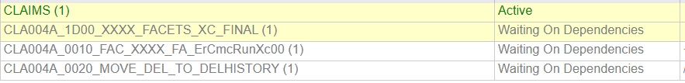
CLA004A
The Final XC load starts after 7:30PM and after the Primary and CLA303Y have completed
This loads the last of the keywords for the day (created since the 2:30PM run up until this job starts) from PEGA to Facets_XC
FAQs:
By this point, the keyword generation is done (it must be done before CLA303Y starts) since this is the last load to Facets_XC of the day
If keywords are done, claims loading is also done
This does not stop claims loading or keyword generation, but they should be done before this starts

Slide 8
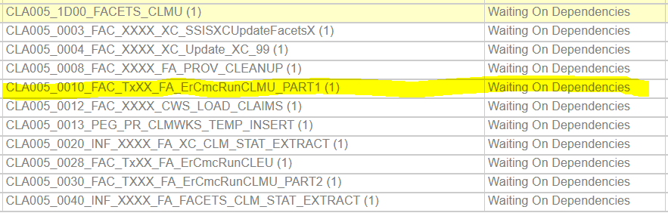
CLA005
The second CLMU Load –the Cleanup- starts after the final XC load
This loads the keywords from Facets_XC into GBD_Facets
This also attempts to load older claims into GBD_Facets, not just new day claims
CLA005 Step 10 runs the cleanup load
Step 10 cannot run past 12:30AM, so CLA009 can start with enough time to meet SLA. If it does, it will need to be killed.
We will be alerted by CLA101X failure if the Cleanup is still running at 12:15AM

Slide 9
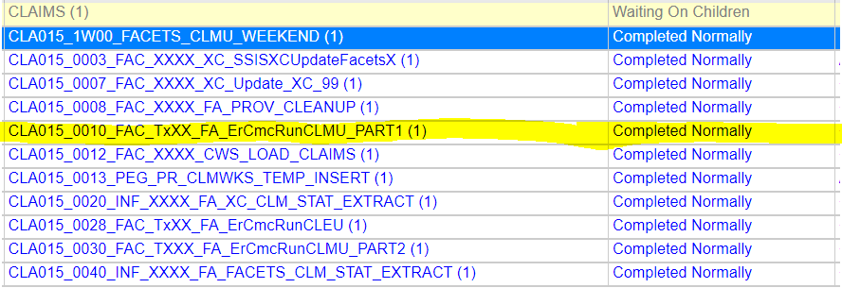
CLA015
The weekend cleanup
The only CLMU that runs on Saturday or Sunday
Scheduled to start at 7PM on Saturday and Sunday
On Saturday, runs after CLA009, so does not need to be killed by 12:30PM
On Sunday, runs before CLA009, so needs to be killed by 12:30PM
Cannot run during maintenance, so the run schedule may change depending on maintenance for the weekend

Slide 10
How to monitor this?
We can monitor the CLMU Loads 3 ways (YOU SHOULD USE ALL 3):
A query run in SQL Developer
Going to the log file for the current run: \\va01pstodfs003.corp.agp.ads\apps\Facets\Prod\TZG\Logs\GBFAC01P and checking the logs
Checking the job in Tidal

Slide 11
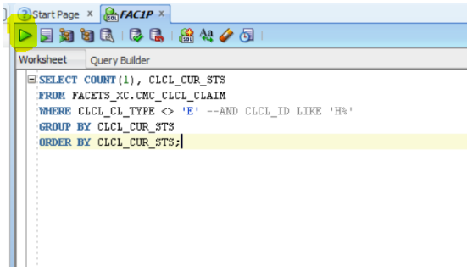
SQL Developer
Open SQL Developer and connect to FAC1P
Put in the following query and run it
SELECT COUNT(1), CLCL_CUR_STS FROM FACETS_XC.CMC_CLCL_CLAIM WHERE CLCL_CL_TYPE <> 'E' --AND CLCL_ID LIKE 'H%' GROUP BY CLCL_CUR_STS ORDER BY CLCL_CUR_STS;

Slide 12
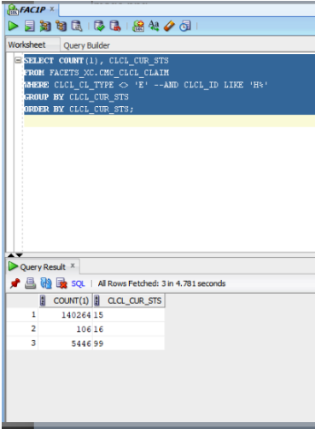
SQL Developer
The results will have 2 columns: Count and CLCL_CUR_STS (Status)
There are 3 different statuses, each with a different meaning:
16: indicates the number of keywords loaded to Facets_XC that have not been filtered to GBD Facets
15: indicates the number of keywords that are in Facets_XC that have attempted to move to GBD Facets but were unable to for some reason
99: indicates the number of keywords successfully loaded to GBD Facets
Monitoring the XC Loads:
Status 16 should be increasing
Status 99 should do nothing
Monitoring the CLMU Load/Cleanup:
Status 16 Count should go down
Status 99 Count should go up
Should see a difference in numbers every refresh
At the end, there may be Counts left in 16. That’s okay. As long as the counts have gone up for 99 and gone down significantly for 16, we're fine.
Step 30 of the cleanup jobs delete the 99 status

Slide 13
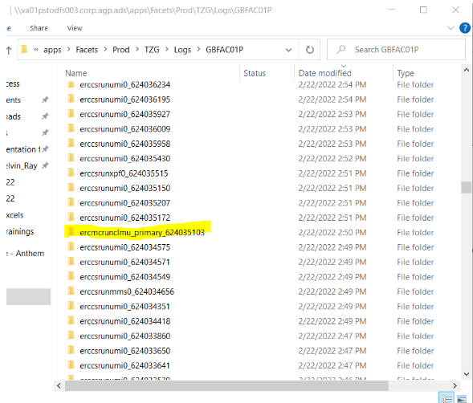
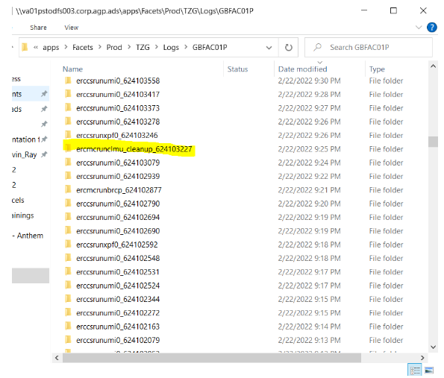
Log Files
Go to the following file path and sort by Date Modified: \\va01pstodfs003.corp.agp.ads\apps\Facets\Prod\TZG\Logs\GBFAC01P
Go to the time that the CLMU Load step started in Tidal (step 20 for CLA002B, step 10 for CLA005/CLA015).

Slide 14
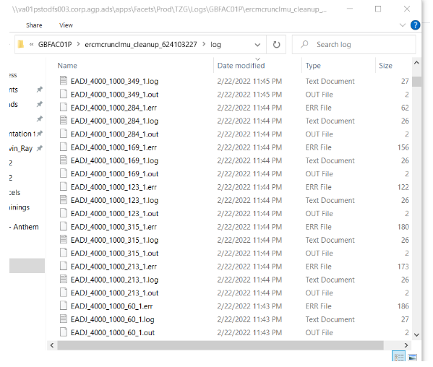
Log Files
Once you select the right folder (primary or cleanup), then select log, then sort by Date Modified
Log files should be generated at least every minute, if not more frequently
When logs don’t generate for 30 minutes, call the COPS on call

Slide 15
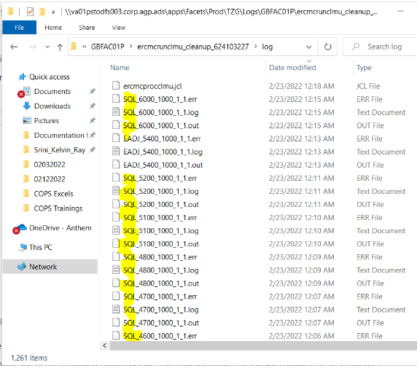
Log Files
When the job is close to completing, files beginning with SQL will populate
This typically means the job will complete in 30-45 minutes
The query will not move at this point. Status 16 and 99 will stay as they are
The last file to populate will be a .jcl file (it won’t be the only .jcl file to populate)

Slide 16
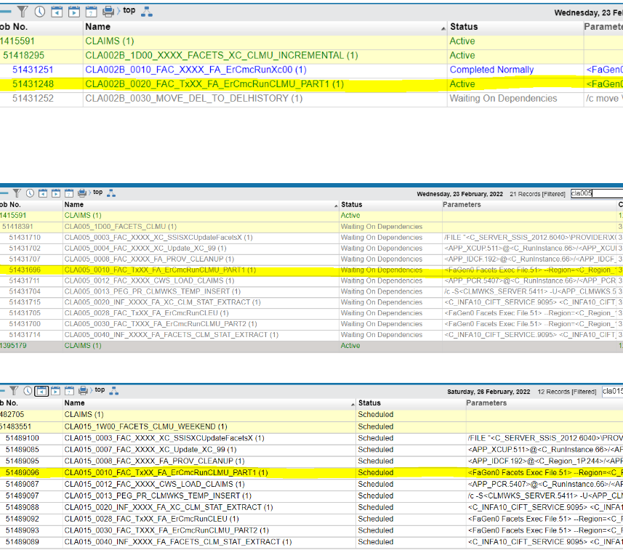
Tidal
Least effective method to monitor the progress of the primary and cleanup
Effective to monitor for the XC loads so we know when to start the monitoring for the primary and cleanup
Remember the primary is step 20 of CLA002B and the cleanup is step 10 of CLA005 (or CLA015 on weekends).
WHEN THE STEPS ARE DONE, THE PRIMARY/CLEANUP IS DONE

Slide 17
Confluence
All this information is also located on confluence here:
https://confluence.anthem.com/display/TA/How+to+Monitor+the+CLMU+Load

